Slide 1
SLEEP EFFICIENCY MODELING
Team Members:
Sri Sailaja Bobba - 1002161911
Vinay Datta Chenimineni - 1002159126
Pavan Reddy Gaddam – pxg1152
Ashlesha Gottipati - 1002169547
Sai Prasad Chowdary Podili - 1002211229

Slide 2
CONTENTS
Project Charter
Model Development
Ongoing progress/Analysis
Future work

Slide 3
Project Name: Sleep efficiency modeling | Champion:
Business or Process Owner: TBD | Project Leader:
Problem Statement: Many individuals struggle to understand and improve their sleep quality due to a lack of insights into their sleep patterns and influencing factors. This project aims to bridge that gap by analyzing sleep data to identify key determinants of sleep efficiency. | Project Goal: To develop a statistical model that can predict sleep efficiency based on various input variables. This model will serve as a foundation for developing tools that help individuals optimize their sleep quality based on personalized data analysis.
Business Case: This project addresses the need for better sleep quality management tools by providing a data-driven approach to sleep analysis. By offering insights into sleep patterns and predictors of sleep efficiency, it enables individuals to make informed decisions about their sleep habits, potentially improving their overall health and productivity. For businesses, this can translate into opportunities for developing health and wellness products tailored to improving sleep quality. | Project Scope: The scope of this project includes collecting and preprocessing sleep data, developing a predictive model for sleep efficiency, and evaluating the model's accuracy. The project will focus on variables such as sleep duration, environmental factors, and lifestyle habits. It will exclude the development of physical products or medical interventions.
 | Benefits: Enabling individuals to gain insights into their sleep patterns, identifying changes that could improve sleep quality, and providing a scientific basis for sleep-related advice and products. For the broader community, it contributes to the understanding of sleep health and its impact on well-being.

Slide 4
DATASET OVERVIEW
The dataset on sleep efficiency, hosted on Kaggle, tracks sleep data collected from wearable devices over multiple nights for various individuals.
It aims to analyze sleep quality, particularly focusing on the efficiency of sleep each night.
The dataset encompasses several key metrics, including the duration of sleep, periods of wakefulness, and overall sleep efficiency percentages.
With a structure designed for detailed analysis, the data can support investigations into sleep patterns, influences on sleep quality, and potential interventions to improve sleep health

Slide 5
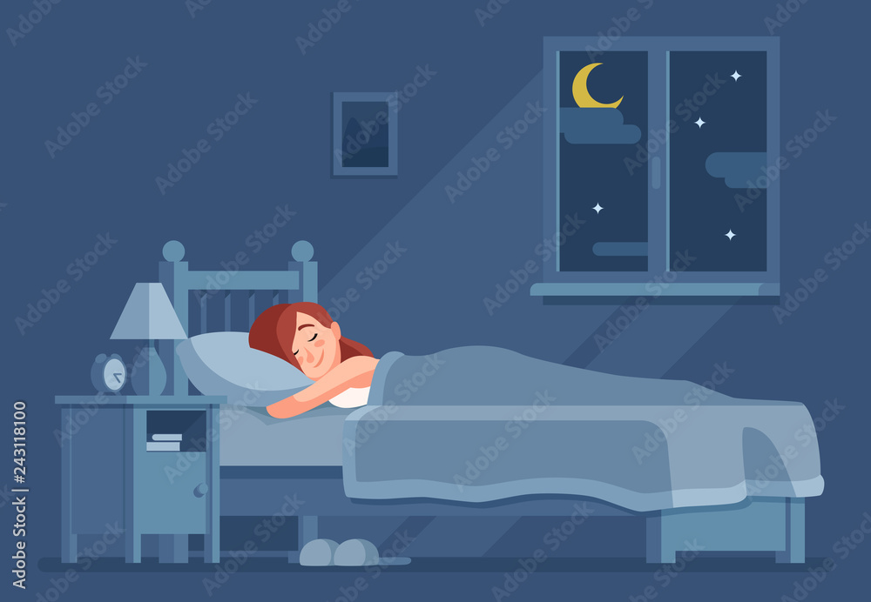
The Predictors
AGE: age of the test subject in years
GENDER: gender of a test subject (Female/Male)
SLEEP_DURATION: the total amount of time the test subject slept (in hours)
SLEEP_EFFICIENCY: a measure of the proportion of time in bed spent asleep
REM_SLEEP_PERCENTAGE: the percentage of total sleep time spent in REM sleep
DEEP_SLEEP_PERCENTAGE: the percentage of total sleep time spent in deep sleep
LIGHT_SLEEP_PERCENTAGE: the percentage of total sleep time spent in light sleep
AWAKENINGS: the number of times the test subject wakes up during the night
CAFFEINE_CONSUMPTION: the amount of caffeine consumed in the 24 hours before bedtime (in mg)
ALCOHOL_CONSUMPTION: the amount of caffeine consumed in the 24 hours before bedtime (in mg)
SMOKING_STATUS: whether or not the test subject smokes (Yes/No)
EXERCISE_FREQUENCY: the number of times the test subject exercises each week

Slide 6
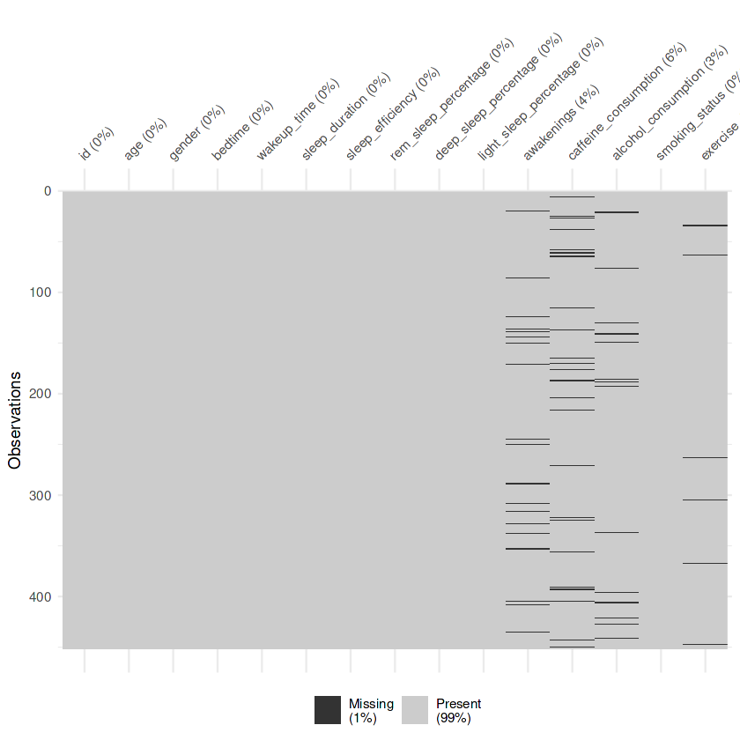
DATA COLLECTION
Below graph represents the missing and present data plotted from the 450 observations.

Slide 7
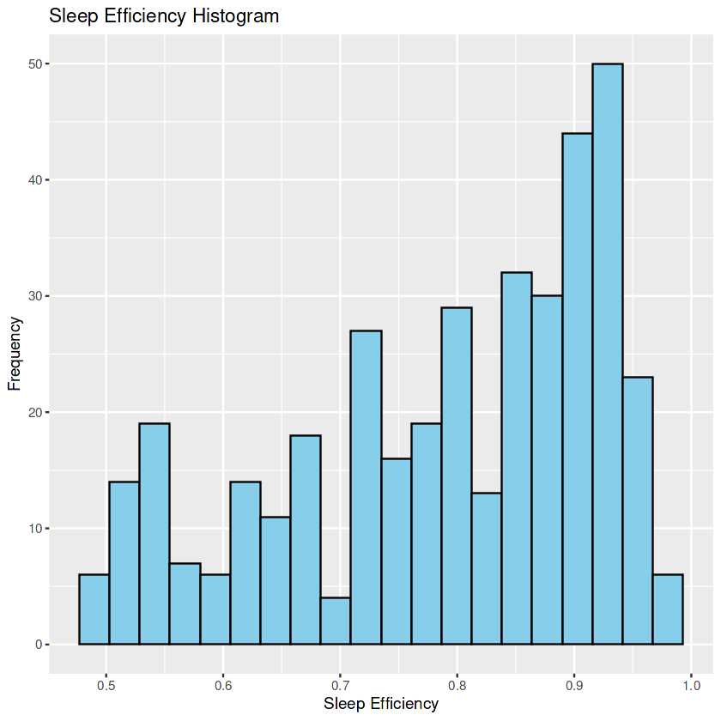
Exploratory data analysis
Sleep Efficiency Distribution
TRY IT YOURSELF WITH ANY OF THESE MODELS

Slide 8
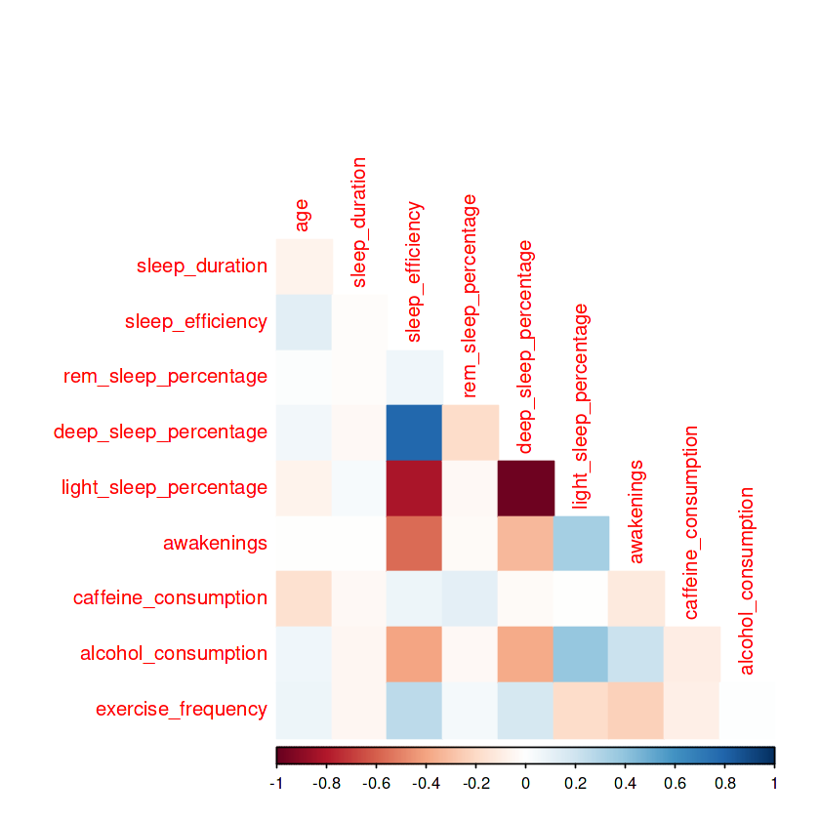
2. Correlation

Slide 9
MODEL DEVELOPMENT
The dataset encompasses a diverse array of sleep-related metrics, age, gender, and several lifestyle factors that could potentially influence sleep quality. With over 450 observations, this rich repository of sleep-related data serves as a comprehensive foundation for exploring the complex interplay between sleep patterns and efficiency.
We have observed the data using linear regression, k-nearest neighbor regression, elastic net regression, and random forest regression models.
By evaluating different predictive models and their variables, there is a gained insight into how data can be modeled to reflect the effectiveness of a person’s sleep patterns.

Slide 10
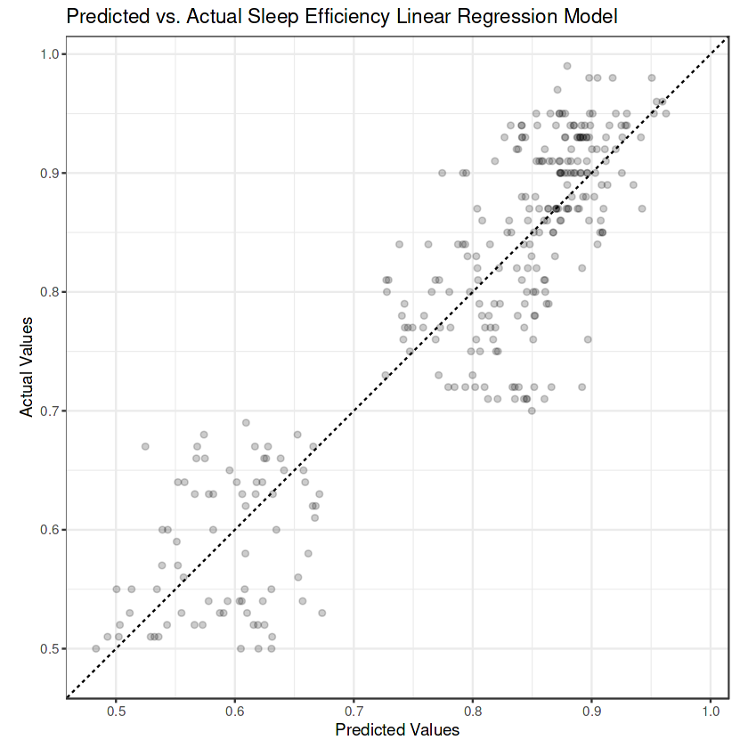
Linear regression data modeling
Linear regression is a statistical method used to model the relationship between a dependent variable and one or more independent variables by fitting a linear equation to observed data.
The model estimates the coefficients in the linear regression formula to best fit the observed data points, aiming to minimize the sum of squared differences between predicted and actual values.
Linear Regression, while a simpler model, showed reasonable performance, likely due to its ability to capture linear relationships, but it might struggle with non-linear relationships in the data.
We can see from the graph that some of the predictions are good, but the model is not the best.

Slide 11
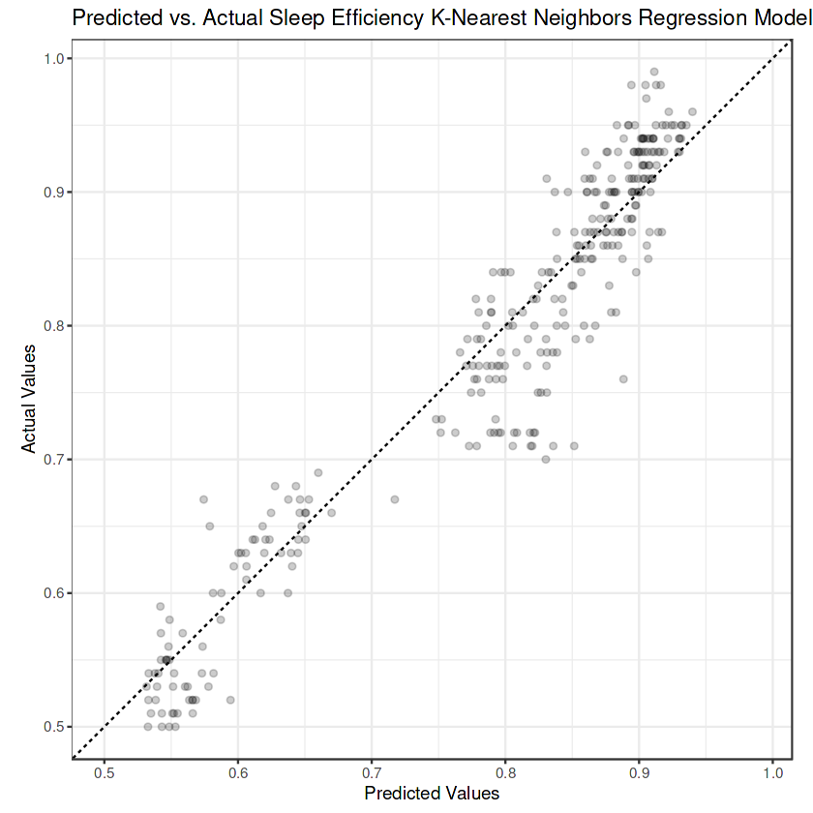
K Nearest Neighbour Regression Data Modeling
K-Nearest Neighbors (KNN) Regression is a non-parametric machine learning algorithm used for regression tasks, where the goal is to predict a continuous target variable.
In KNN regression, predictions for new data points are made by averaging the target values of the K nearest neighbors.
The algorithm doesn't explicitly learn a model.
The relatively strong performance of KNN suggests its effectiveness in capturing local patterns, though its performance might depend on the chosen hyperparameters and the specific nature of the data
We can see that the predictions are very close to the y = x line. The model is successful.

Slide 12
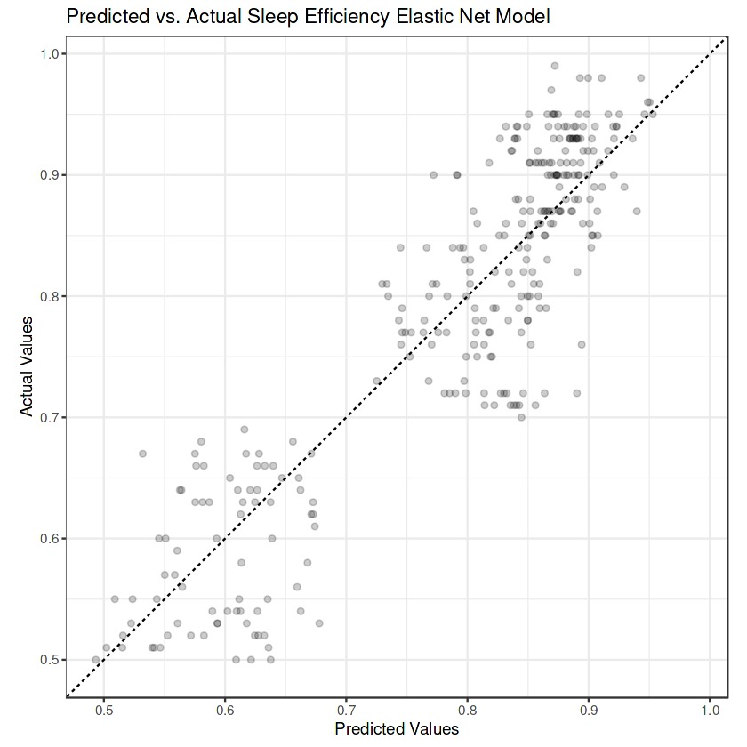
Elastic Net Regression Model
In data modeling, Elastic Net regression is a powerful technique used for predicting a target variable based on a set of predictor variables. It's particularly effective when dealing with datasets where there are many correlated predictors, as it combines the advantages of both Lasso and Ridge regression.
Process:
a)Variable selection
b)Shrinkage
c)Objective function
d)Regularization parameters
The relatively weaker performance of Elastic Net could be a surprise if initial expectations suggested it would perform better.
Elastic Net Regression performed least effectively among the models considered, potentially due to its limitations in capturing complex interactions or needing more fine-tuning of its hyperparameters for better performance.

Slide 13
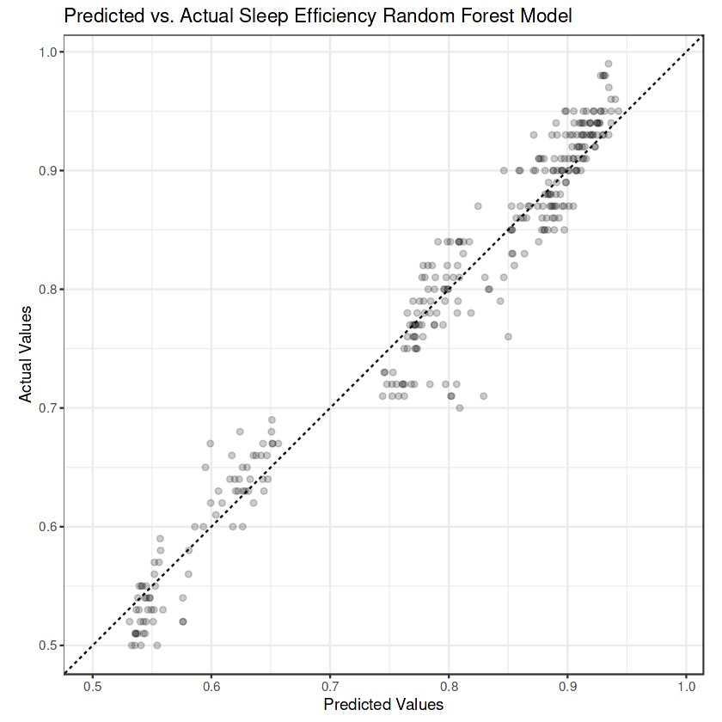
Random Forest Regression Model
Random Forest regression is a powerful ensemble learning method used for regression tasks. It belongs to the family of decision tree algorithms but builds multiple decision trees and combines their predictions to improve accuracy and reduce overfitting.
Process: a) Data Preprocessing b) Feature Selection/Engineering
c) Model Training
d)Model Evaluation
e) Hyperparameter Tuning
f) Final Model Deployment
g) Interpretation and Analysis
The Random Forest model's superior performance might be due to its ability to handle complex relationships and interactions between predictors, as well as its robustness against overfitting.

Slide 14
EFFICIENCY OF EACH MODEL
Elastic Net Regression: The efficiency score of this model is 75 out of 100 not the best one in use.
Random Forest Regression: the performance of this model is 82 out of 100 which is the highest of all models comparatively.
Linear Regression: the efficiency rate for linear regression is 68% least dependable and basic model out of all models respectively.
KNN Regression: The performance rate of this model is 79% dependable but has limitations regarding global patterns.

Slide 15
FUTURE WORK
Deep Learning Exploration: Investigate deep learning techniques like recurrent neural networks (RNNs) or Long Short-Term Memory (LSTM) networks to capture complex sleep patterns and relationships.
Personalized Modeling: Develop personalized sleep efficiency models that account for individual differences in sleep behaviors, physiology, and environmental factors.
Clinical Integration: Extend the model's application to clinical settings for diagnosing sleep disorders, monitoring treatment effectiveness, and providing personalized sleep recommendations.

Slide 16
CONCLUSION
The conclusion highlights the performance of various regression models on the dataset, with Random Forest emerging as the top performer due to its ability to handle complex relationships and interactions between predictors.
K-Nearest Neighbors (KNN) showed strong performance in capturing local patterns, while Linear Regression demonstrated decent predictive power despite its simplicity.
Elastic Net Regression lagged, suggesting potential for improvement through parameter tuning or feature selection strategies.
Overall, the conclusion provides insights into the dataset characteristics and underscores the potential for enhancing predictive accuracy through further model refinement.

